Slide 1
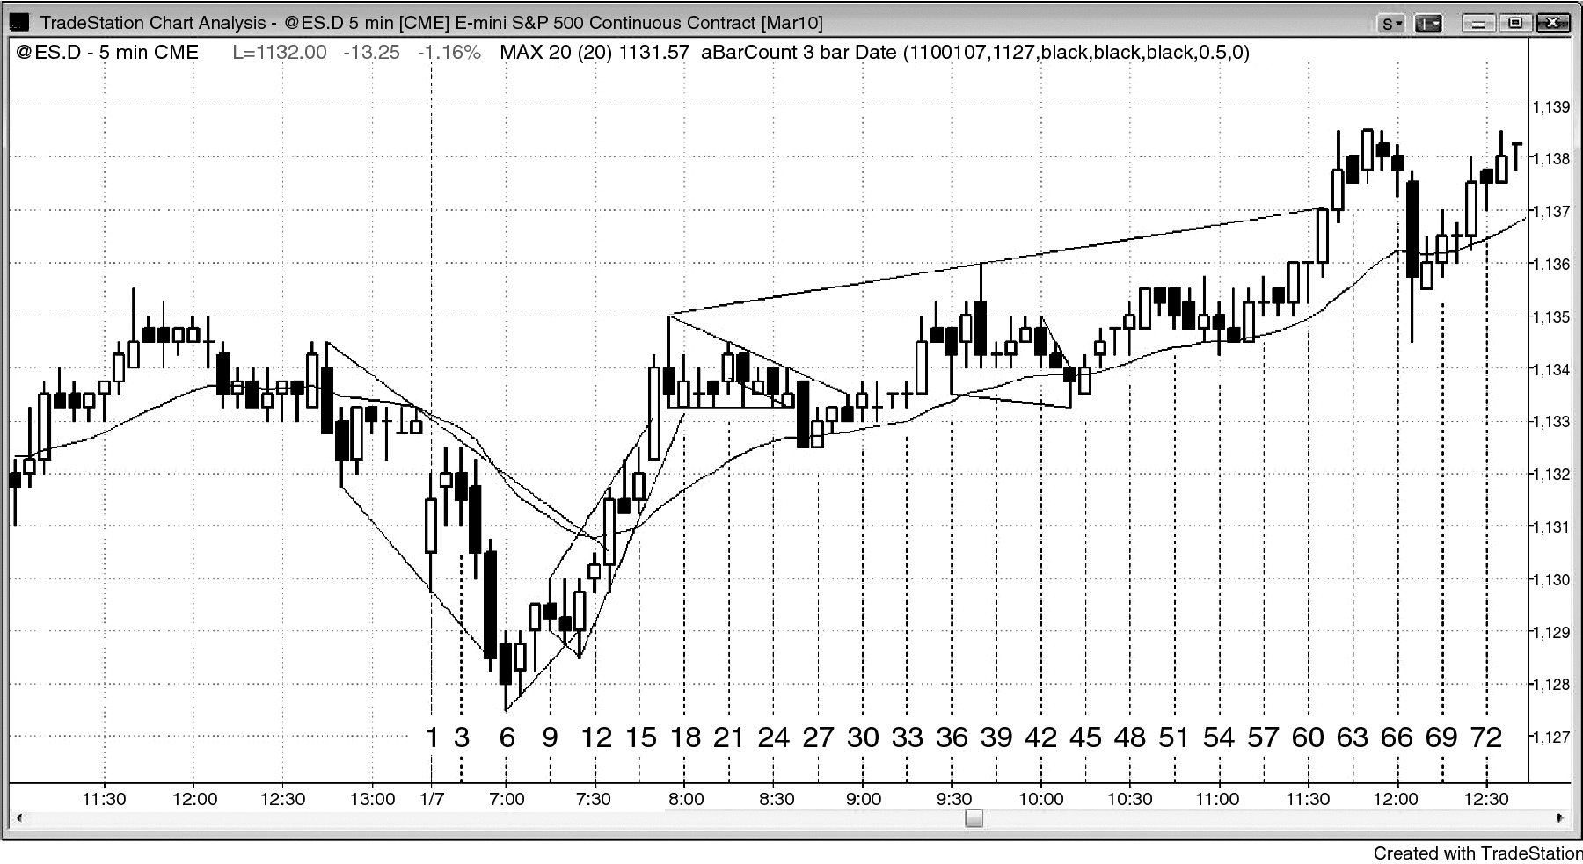
FIGURE 16.1 Extreme Scalping

